Slide 1


Charm++: An Asynchronous Parallel Programming Model with an Intelligent Adaptive Runtime System
Laxmikant (Sanjay) Kale
http://charm.cs.illinois.edu
Parallel Programming Laboratory
Department of Computer Science
University of Illinois at Urbana Champaign

Slide 2
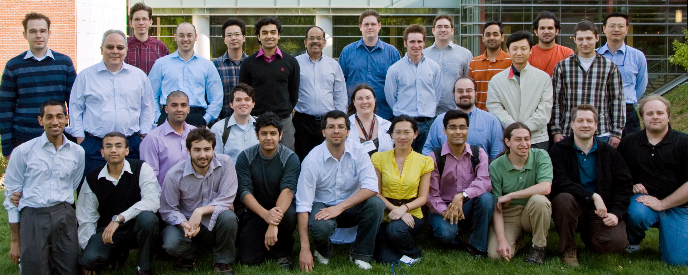
Parallel Programming Laboratory

Slide 3
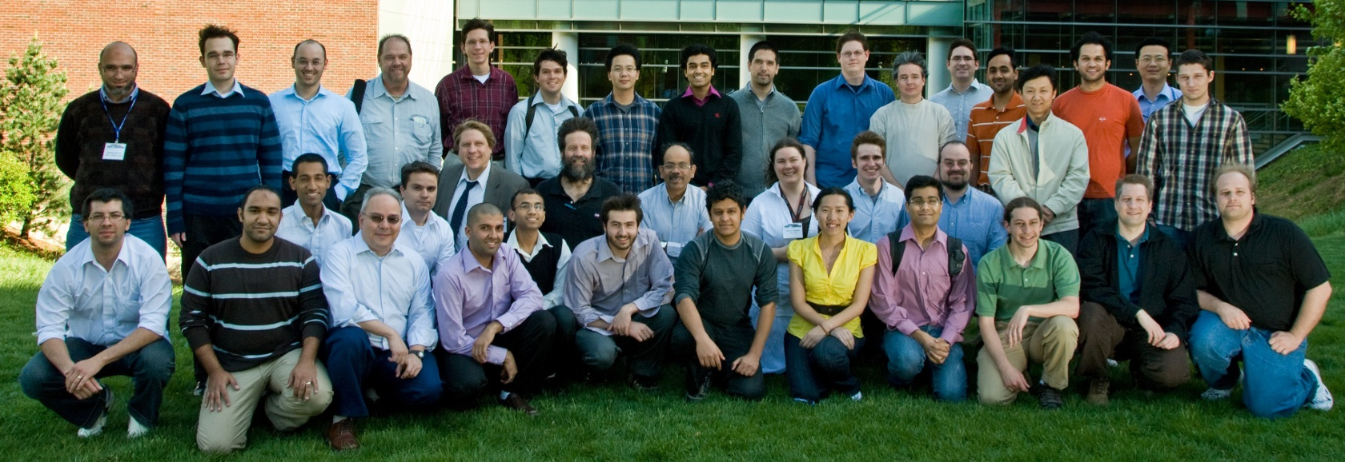
Parallel Programming Laboratory with Collaborators

Slide 4
Observations: Exascale applications
Development of new models must be driven by the needs of exascale applications
Multi-resolution
Multi-module (multi-physics)
Dynamic/adaptive: to handle application variation
Adapt to a volatile computational environment
Exploit heterogeneous architecture
Deal with thermal and energy considerations
So? Consequences:
Must support automated resource management
Must support interoperability and parallel composition

Slide 5
Decomposition Challenges
Current method is to decompose to processors
But this has many problems
deciding which processor does what work in detail is difficult at large scale
Decomposition should be independent of number of processors
My group’s design principle since early 1990’s
in Charm++ and AMPI

Slide 6
Processors vs. “WUDU”s
Eliminate “processor” from programmer’s vocabulary
Well, almost
Decomposition into:
Work-Units and Data Units (WUDUs)
Work-units: code, one or more data units
Data-units: sections of arrays, meshes, …
Amalgams:
Objects with associated work-units,
Threads with own stack and heap
Who does decomposition?
Programmer, compiler, or both

Slide 7
Different kinds of units
Migration units:
objects, migratable threads (i.e., “processes”), data sections
DEBs: units of scheduling
Dependent Execution Block
Begins execution after one or more (potentially) remote dependence is satisfied
SEBs: units of analysis
Sequential Execution Blocks
A DEB is partitioned into one or more SEBs
Has a “reasonably large” granularity, and uniformity in code structure
Loop nests, functions, …

Slide 8
Migratable objects programming model
Names for this model:
Overdecompostion approach
Object-based overdecomposition
Processor virtualization
Migratable-objects programming model

Slide 9
Adaptive Runtime Systems
Decomposing program into a large number of WUDUs empowers the RTS, which can:
Migrate WUDUs at will
Schedule DEBS at will
Instrument computation and communication at the level of these logical units
WUDU x communicates y bytes to WUDU z every iteration
SEB A has a high cache miss ratio
Maintain historical data to track changes in application behavior
Historical => previous iterations
E.g., to trigger load balancing

Slide 10
Over-decomposition and message-driven execution
Scalable Tools
Automatic overlap, pefetch, compositionality
Emulation for Perf Prediction
Migratability
Fault Tolerance
Introspective and adaptive runtime system
Dynamic load balancing (topology-aware, scalable)
Temperature/power considerations
Higher-level abstractions
Languages and Frameworks
Control Points

Slide 11
Utility for Multi-cores, Many-cores, Accelerators:
Objects connote and promote locality
Message-driven execution
A strong principle of prediction for data and code use
Much stronger than principle of locality
Can use to scale memory wall:
Prefetching of needed data:
into scratch pad memories, for example
Scheduler
Scheduler
Message Q
Message Q
Notes:
Replace figure with a new drawing

Slide 12
Impact on communication
Current use of communication network:
Compute-communicate cycles in typical MPI apps
So, the network is used for a fraction of time,
and is on the critical path
So, current communication networks are over-engineered for by necessity
With overdecomposition
Communication is spread over an iteration
Also, adaptive overlap of communication and computation

Slide 13
Compositionality
It is important to support parallel composition
For multi-module, multi-physics, multi-paradigm applications…
What I mean by parallel composition
B || C where B, C are independently developed modules
B is parallel module by itself, and so is C
Programmers who wrote B were unaware of C
No dependency between B and C
This is not supported well by MPI
Developers support it by breaking abstraction boundaries
E.g., wildcard recvs in module A to process messages for module B
Nor by OpenMP implementations:

Slide 14
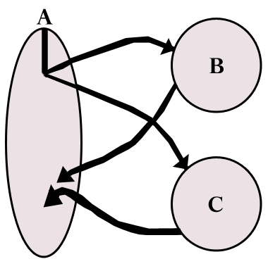
Without message-driven execution (and virtualization), you get either:
Space-division
B
C
Time
Notes:
Replace “scanned” diagram on the left with a better one, in all the slides that use this.

Slide 15
OR: Sequentialization
B
C
Time

Slide 16
Parallel Composition: A1; (B || C ); A2
Recall: Different modules, written in different languages/paradigms, can overlap in time and on processors, without programmer having to worry about this explicitly

Slide 17
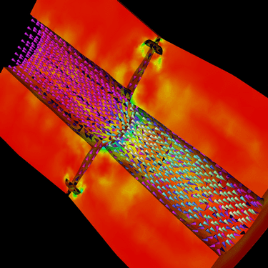
Decomposition Independent of numCores
Rocket simulation example under traditional MPI
With migratable-objects:
Benefit: load balance, communication optimizations, modularity
Solid
Solid
. . .
Solid
Fluid
Fluid
Fluid
1 2 P
Solid₁
Solid₂
Solid₃
. . .
Solid_{n}
Fluid₁
Fluid₂
. . .
Fluid_{m}
Notes:
17
In traditional MPI paradigm. The number of partitions of both modules is typically equal to the number of processor P
And although the i’th elements of fluid module and solid module are not connected geometrically in the simulation, they are glued together on the I’th processor.
Under Charm++/AMPI framework, the two modules each get their own set of parallel objects. And the size of the arrays are not restricted or related.
The benefit of this is performance optimizations and better modularity.
Problem: due to the asynchronous method invocation, the flow of control is buried deep into the object code

Slide 18
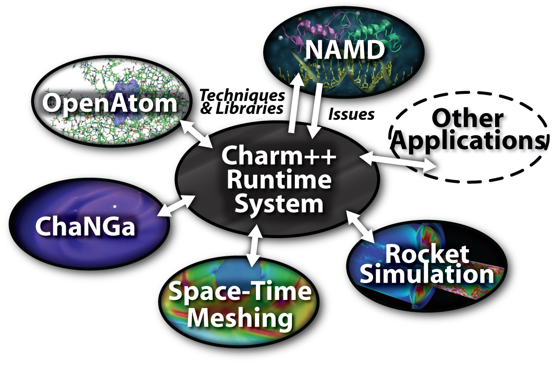
Charm++ and CSE Applications
Well-known Biophysics molecular simulations App
Gordon Bell Award, 2002
Nano-Materials..
Synergy
Enabling CS technology of parallel objects and intelligent runtime systems has led to several CSE collaborative applications
ISAM
Computational Astronomy
_{CharmSimdemics}
_{Stochastic}
_{Optimization}

Slide 19
Object Based Over-decomposition: Charm++
Multiple “indexed collections” of C++ objects
Indices can be multi-dimensional and/or sparse
Programmer expresses communication between objects
with no reference to processors
System implementation
User View

Slide 20
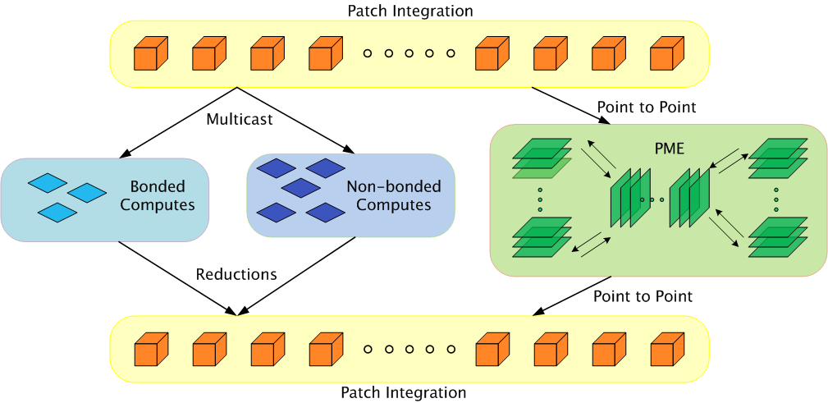
Parallelization Using Charm++
The computation is decomposed into “natural” objects of the application, which are assigned to processors by Charm++ RTS
Bhatele, A., Kumar, S., Mei, C., Phillips, J. C., Zheng, G. & Kale, L. V. 2008 Overcoming Scaling Challenges in Biomolecular Simulations across Multiple Platforms. In Proceedings of IEEE International Parallel and Distributed Processing Symposium, Miami, FL, USA, April 2008.

Slide 21
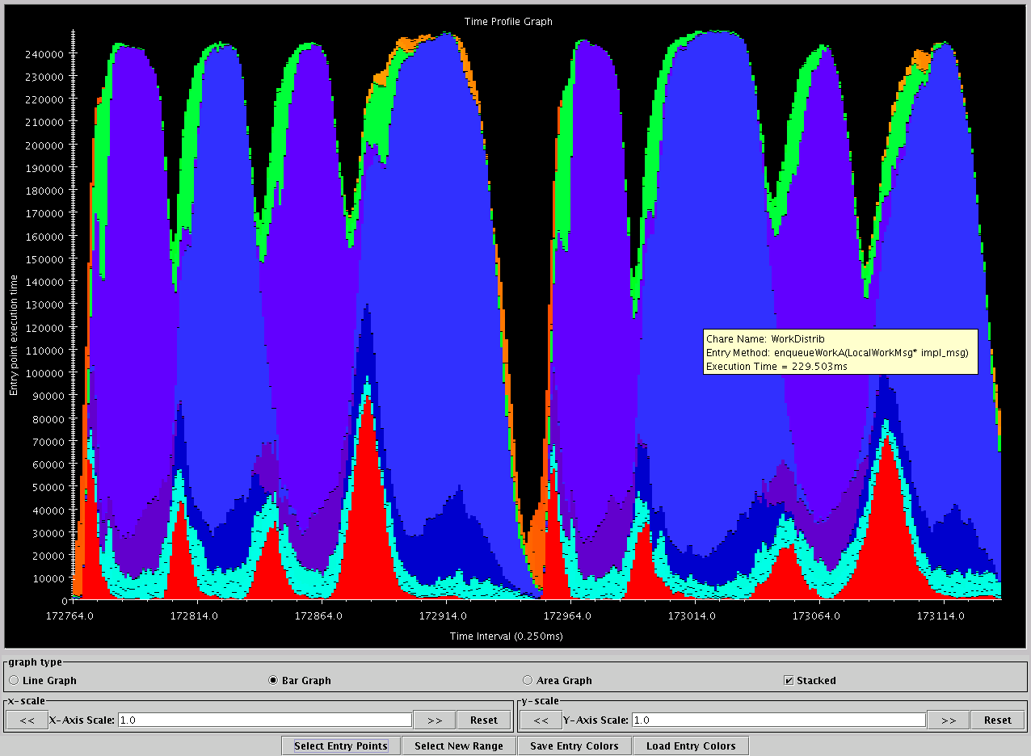
Apo-A1, on BlueGene/L, 1024 procs
Charm++’s “Projections” Analysis tool
Time intervals on x axis, activity added across processors on Y axis
green: communication
Red: integration
Blue/Purple: electrostatics
Orange: PME
turquoise: angle/dihedral
Time

Slide 22
Performance on Intrepid (BG/P)

Slide 23
SMP Performance on Titan(Dev)
Timestep (ms/step)
13ms/step
Number of cores
9 ms/step

Slide 24
Object Based Over-decomposition: AMPI
Each MPI process is implemented as a user-level thread
Threads are light-weight and migratable!
<1 microsecond context switch time, potentially >100k threads per core
Each thread is embedded in a charm++ object (chare)
MPI processes
Virtual Processors (user-level migratable threads)
Real Processors

Slide 25
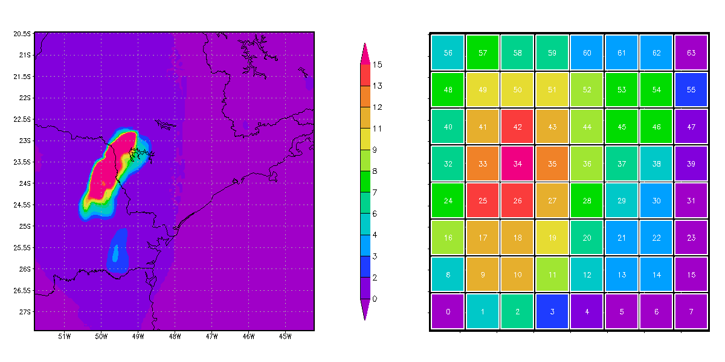
A quick Example: Weather Forecasting in BRAMS
Brams: Brazillian weather code (based on RAMS)
AMPI version (Eduardo Rodrigues, with Mendes and J. Panetta)

Slide 26
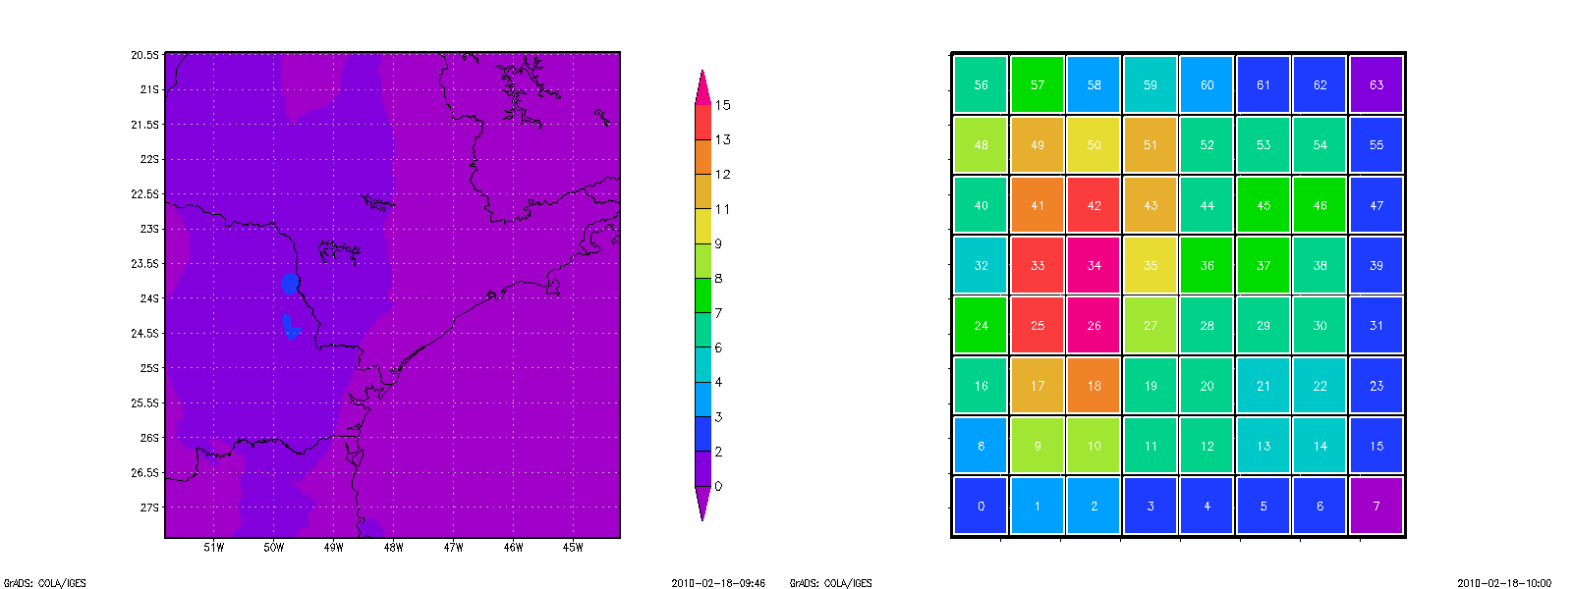


Slide 27
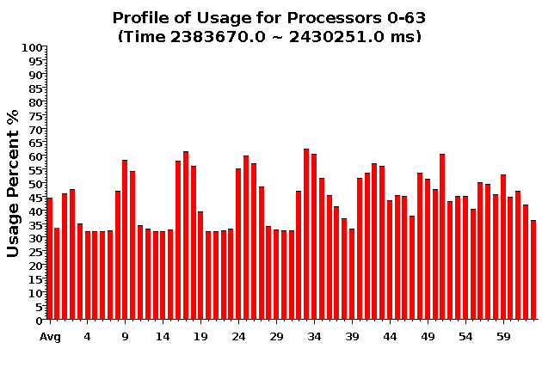
Baseline: 64 objects on 64 processors

Slide 28
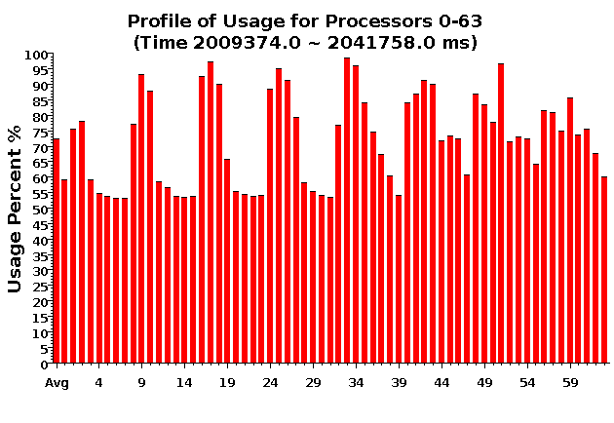
Over-decomposition: 1024 objects on 64 processors:
Benefits from communication/computation overlap

Slide 29
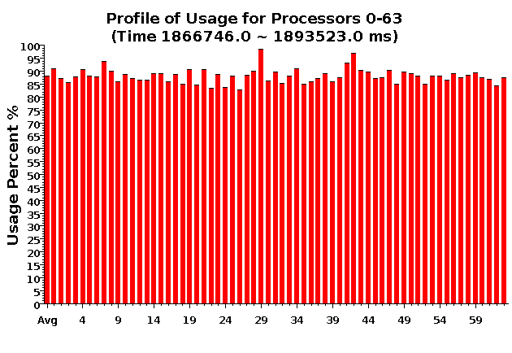
With Load Balancing:
1024 objects on 64 processors
No overdecomp (64 threads) | 4988 sec
Overdecomp into 1024 threads | 3713 sec
Load balancing (1024 threads) | 3367 sec

Slide 30
Principle of Persistence
Once the computation is expressed in terms of its natural (migratable) objects
Computational loads and communication patterns tend to persist, even in dynamic computations
So, recent past is a good predictor of near future
In spite of increase in irregularity and adaptivity, this principle still applies at exascale, and is our main friend.
Notes:
30

Slide 31
Measurement-based Load Balancing
Regular Timesteps
Detailed, aggressive Load Balancing
Instrumented Timesteps
Refinement Load Balancing

Slide 32

ChaNGa: Parallel Gravity
Evolution of Universe and Galaxy Formation
Collaborative project (NSF)
with Tom Quinn, Univ. of Washington
Gravity, gas dynamics
Barnes-Hut tree codes
Oct tree is natural decomp
Geometry has better aspect ratios, so you “open” up fewer nodes
But is not used because it leads to bad load balance
Assumption: one-to-one map between sub-trees and PEs
Binary trees are considered better load balanced
With Charm++: Use Oct-Tree, and let Charm++ map subtrees to processors

Slide 33
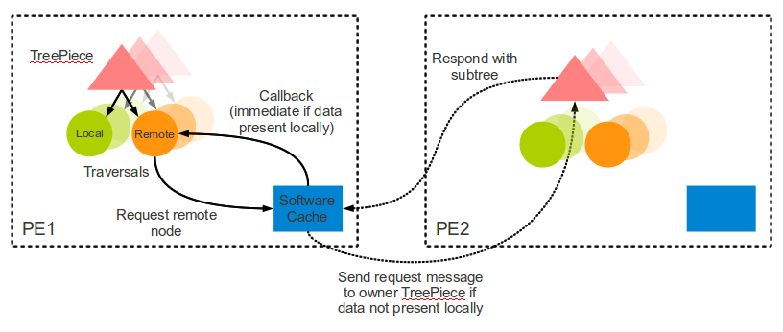
Control flow

Slide 34
CPU Performance

Slide 35
GPU Performance

Slide 36
Load Balancing for Large Machines: I
Centralized balancers achieve best balance
Collect object-communication graph on one processor
But won’t scale beyond tens of thousands of nodes
Fully distributed load balancers
Avoid bottleneck but… Achieve poor load balance
Not adequately agile
Hierarchical load balancers
Careful control of what information goes up and down the hierarchy can lead to fast, high-quality balancers
Need for a universal balancer that works for all applications

Slide 37
Load Balancing for Large Machines: II
Interconnection topology starts to matter again
Was hidden due to wormhole routing etc.
Latency variation is still small
But bandwidth occupancy is a problem
Topology aware load balancers
Some general heuristic have shown good performance
But may require too much compute power
Also, special-purpose heuristic work fine when applicable
Still, many open challenges

Slide 38
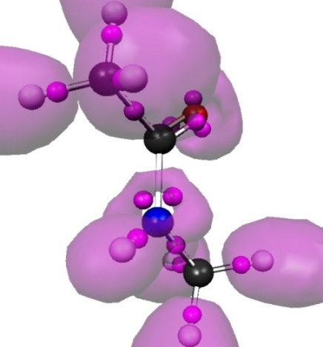
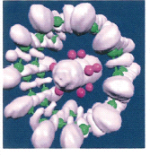
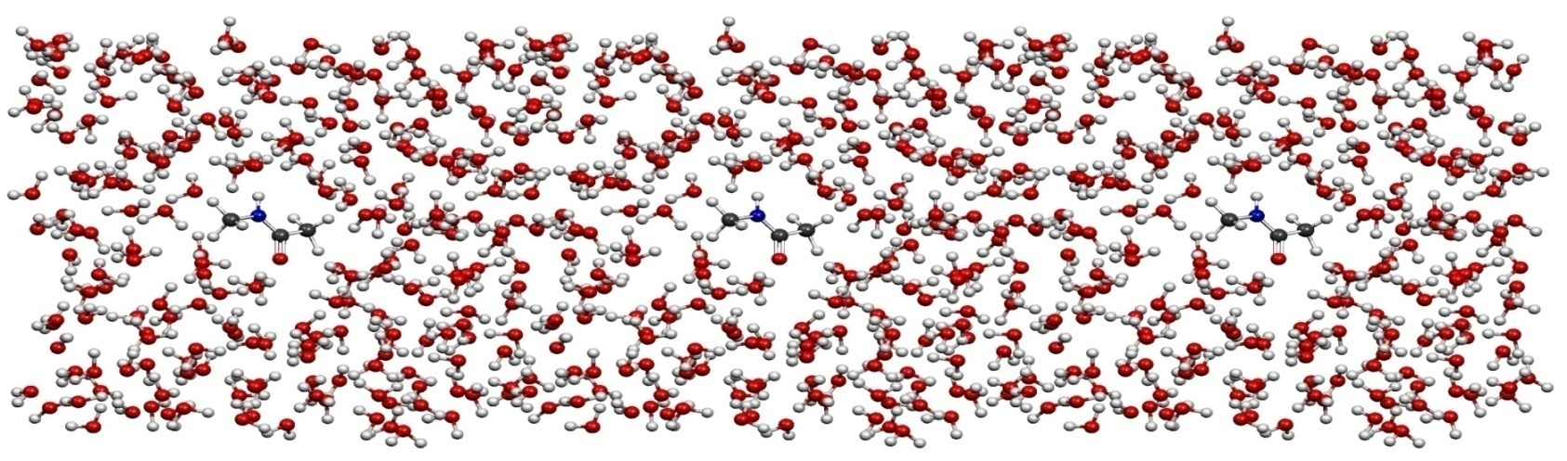
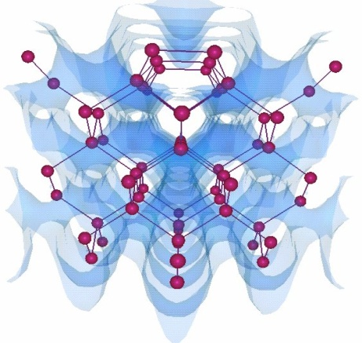
OpenAtom
Car-Parinello Molecular Dynamics
NSF ITR 2001-2007, IBM, DOE
Molecular Clusters :
Nanowires:
G. Martyna (IBM)
M. Tuckerman (NYU)
L. Kale (UIUC)
J. Dongarra
Semiconductor Surfaces:
3D-Solids/Liquids:
Using Charm++ virtualization, we can efficiently scale small (32 molecule) systems to thousands of processors

Slide 39
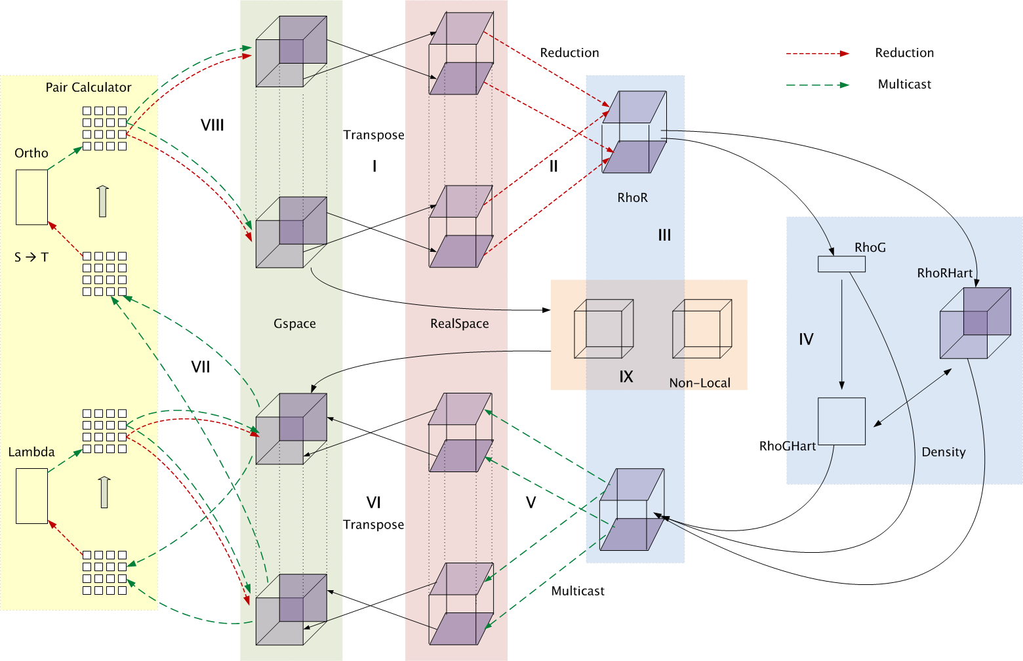
Decomposition and Computation Flow

Slide 40
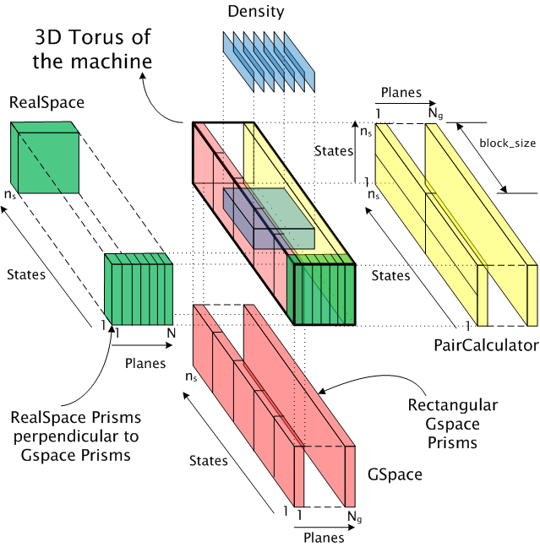
Topology Aware Mapping of Objects

Slide 41
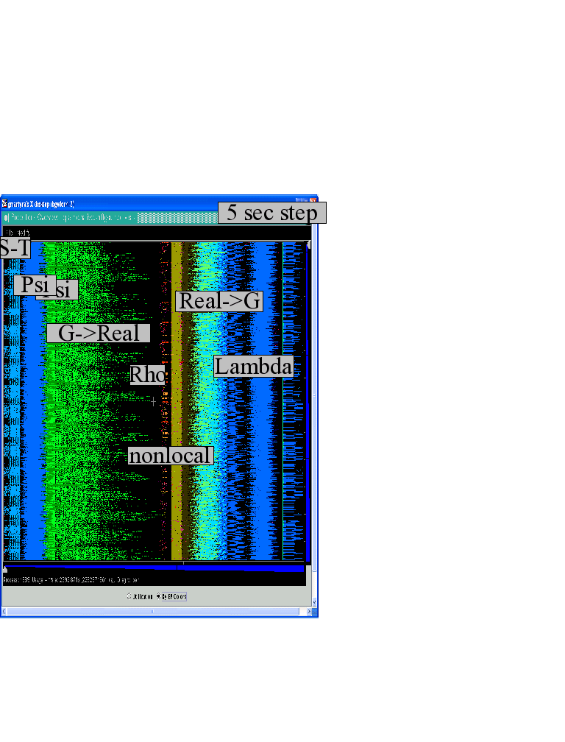
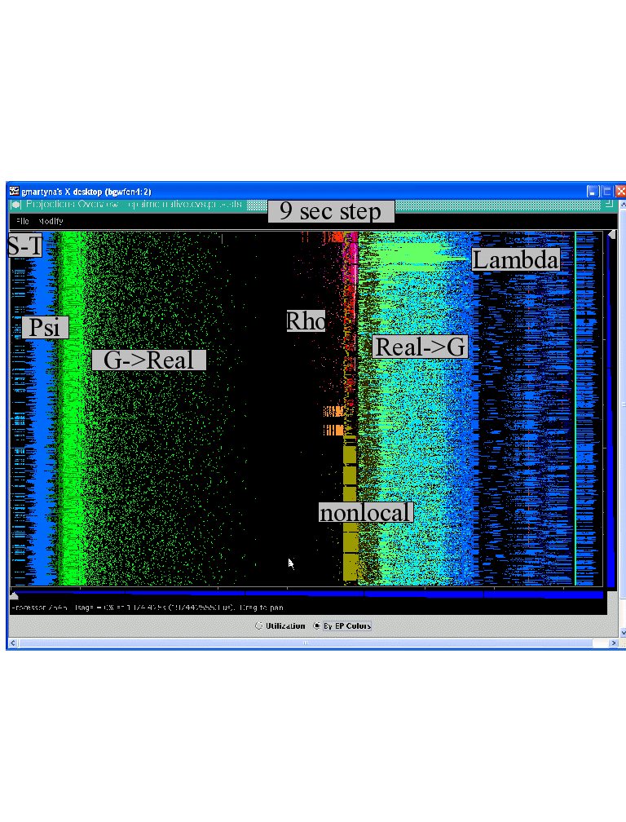

Improvements by topological aware mapping of computation to processors
Punchline: Overdecomposition into Migratable Objects created the degree of freedom needed for flexible mapping
The simulation of the right panel, maps computational work to processors taking the network connectivity into account while the left panel simulation does not. The “black’’ or idle time processors spent waiting for computational work to arrive on processors is significantly reduced at left. (256waters, 70R, on BG/L 4096 cores)

Slide 42
OpenAtom Performance Sampler
Ongoing work on:
K-points

Slide 43
Saving Cooling Energy
Some cores/chips might get too hot
We want to avoid
Running everyone at lower speed,
Conservative (expensive) cooling
Reduce frequency (DVFS) of the hot cores?
Works fine for sequential computing
In parallel:
There are dependences/barriers
Slowing one core down by 40% slows the whole computation by 40%!
Big loss when the #processors is large
Migratable Objects to the rescue!

Slide 44
Temperature-aware Load Balancing
Reduce frequency if temperature is high
Independently for each core or chip
Migrate objects away from the slowed-down processors
Balance load using an existing strategy
Strategies take speed of processors into account
Recently implemented in experimental version
SC 2011 paper

Slide 45
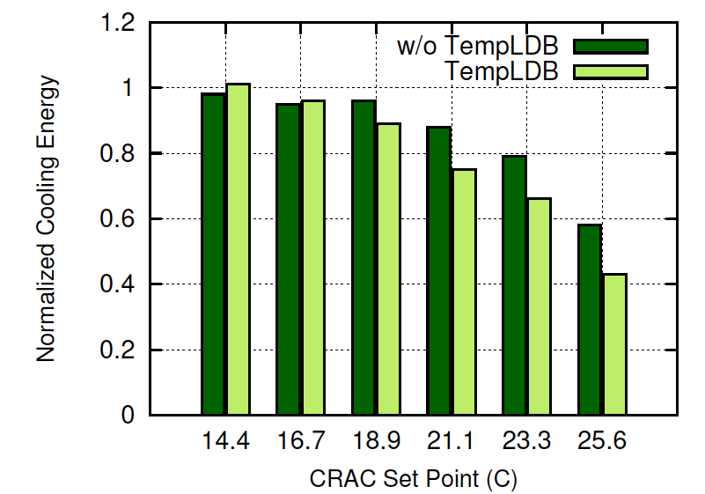
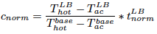
Cooling Energy Consumption
Jacobi2D on 128 Cores
Both schemes save energy as cooling energy consumption depends on CRAC set-point (TempLDB better)
Our scheme saves up to 57% (better than w/o TempLDB) mainly due to smaller timing penalty
Notes:
Saving cooling energy was the motive of our research. To gauge cooling energy saved, we normalized the cooling energy for each run according to the base run where all cores were running with max frequency without temperature control
The figure shows the normalized cooling energy for both the schemes. Both the schemes end up saving some cooling energy but these savings are more in case of our temperature aware load balancer
We end up saving as high as 57% of the cooling cost.

Slide 46
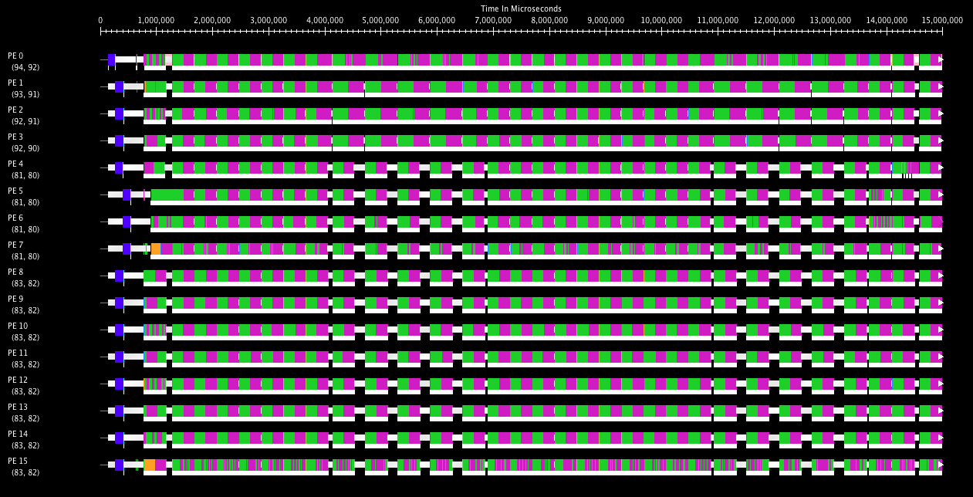
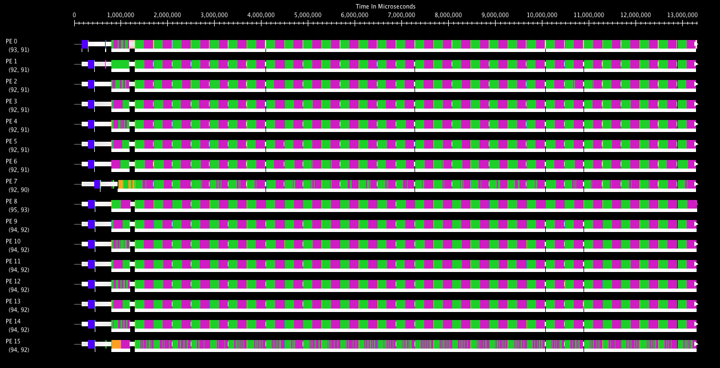
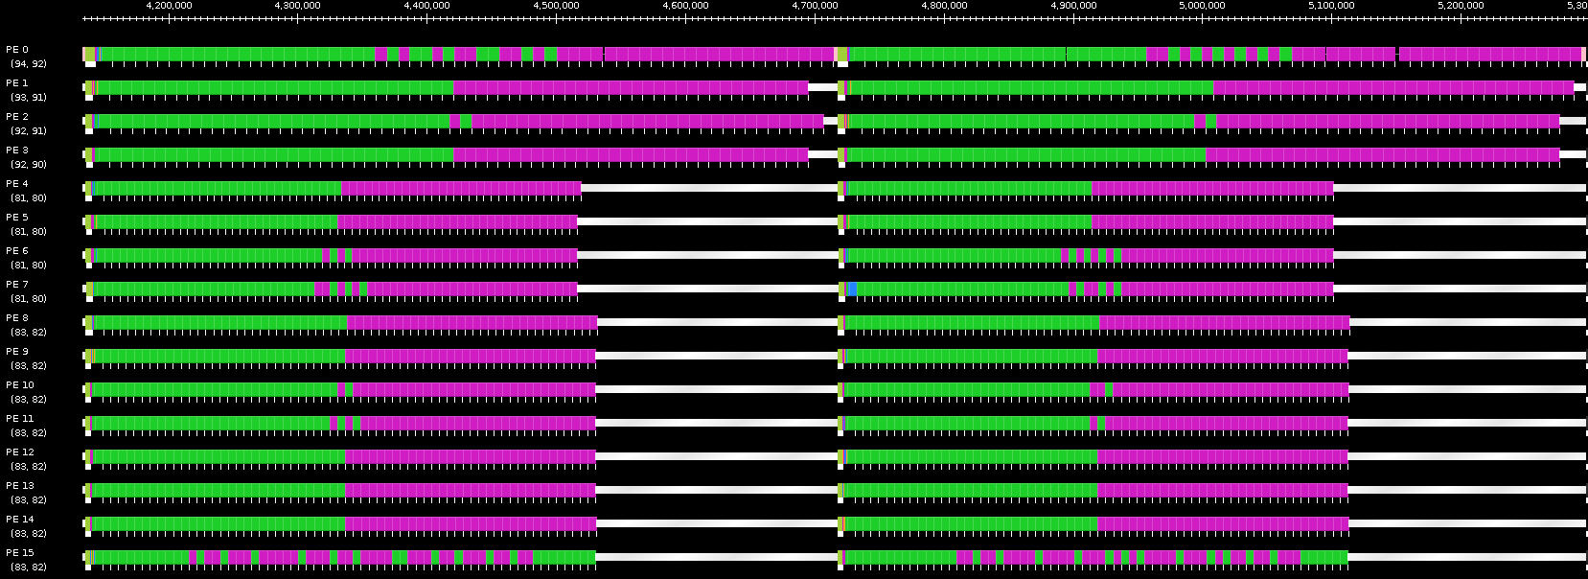
Benefits of Temperature Aware LB
Projections timeline without (top) and with (bottom) temperature aware LB
Zoomed projection timeline for two iterations without temperature aware LB

Slide 47
Benefits of Temperature Aware LB

Slide 48
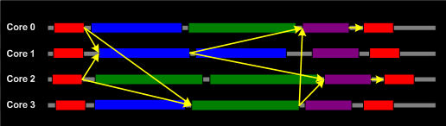
Other Power-related Optimizations
Other optimizations are in progress:
Staying within given energy budget, or power budget
Selectively change frequencies so as to minimize impact on finish time
Reducing power consumed with low impact on finish time
Identify code segments (methods) with high miss-rates
Using measurements (principle of persistence)
Reduce frequencies for those,
and balance load with that assumption
Use critical paths analysis:
Slow down methods not on critical paths
Aggressive: migrate critical-path objects to faster cores

Slide 49
Fault Tolerance in Charm++/AMPI
Four Approaches:
Disk-based checkpoint/restart
In-memory double checkpoint/restart
Proactive object migration
Message-logging: scalable fault tolerance
Common Features:
Easy checkpoint:
migrate-to-disk leverages object-migration capabilities
Based on dynamic runtime capabilities
Can be used in concert with load-balancing schemes
Notes:
49

Slide 50
In-memory checkpointing
Is practical for many apps
Relatively small footprint at checkpoint time
Very fast times…
Demonstration challenge:
Works fine for clusters
For MPI-based implementations running at centers:
Scheduler does not allow job to continue on failure
Communication layers not fault tolerant
Fault injection: dieNow(),
Spare processors

Slide 51
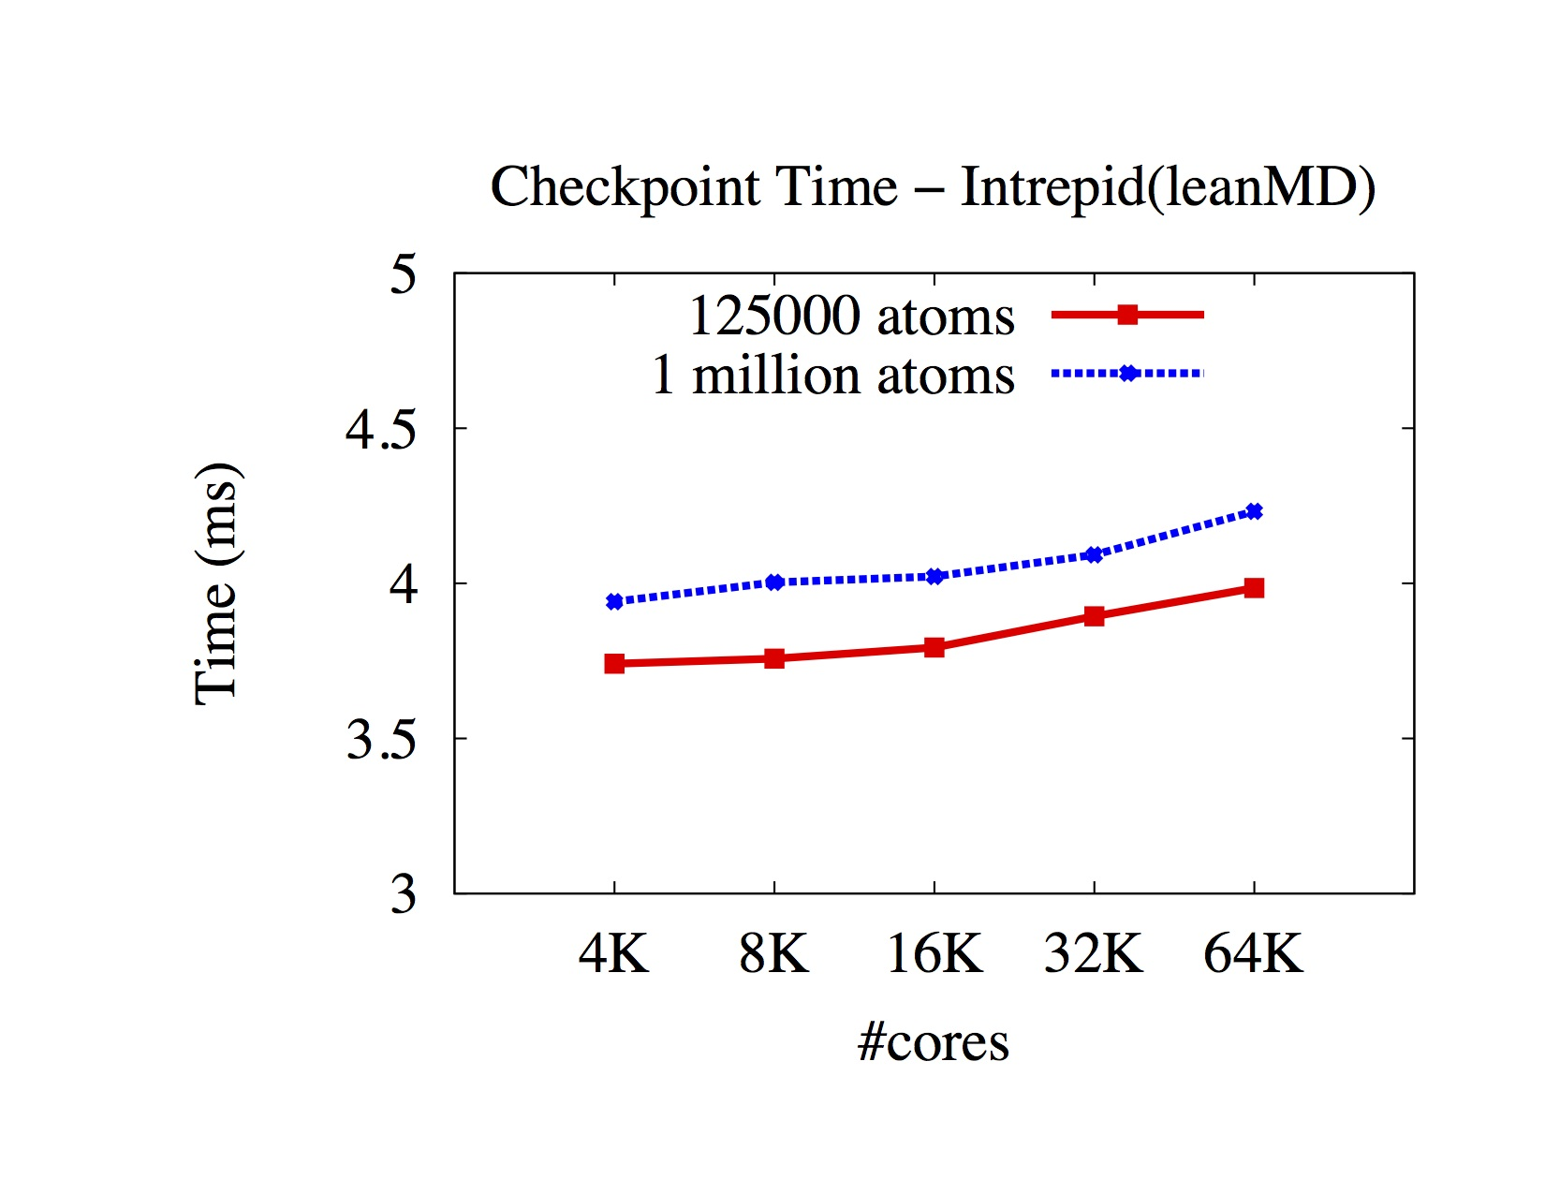

Slide 52
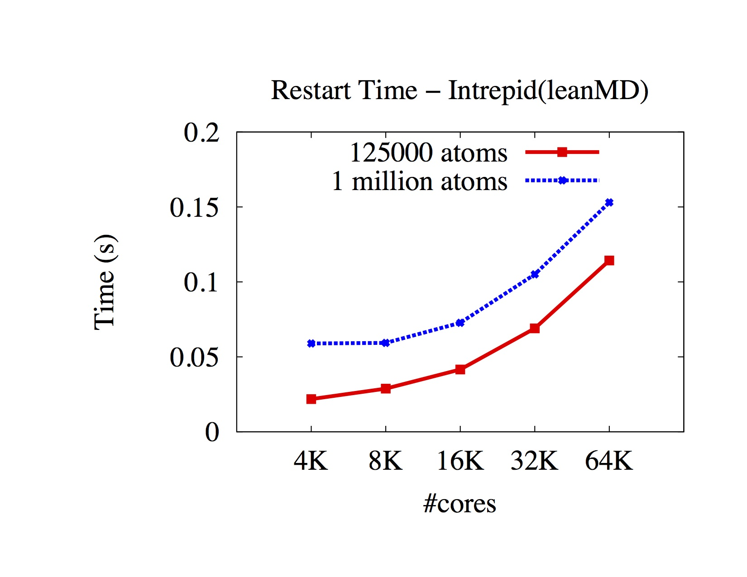

Slide 53
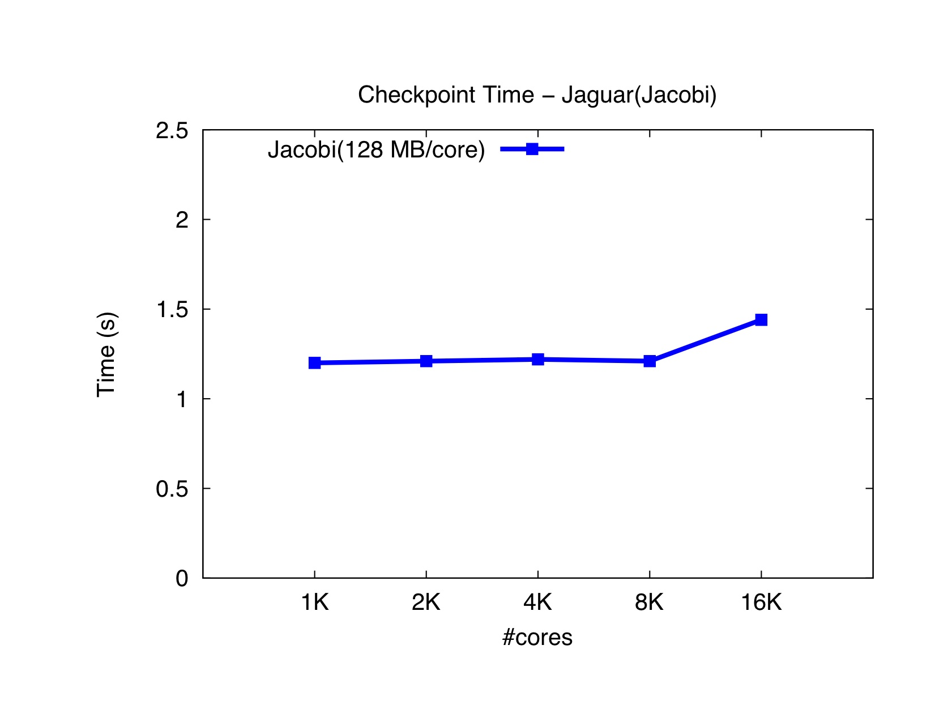

Slide 54
Scalable Fault tolerance
Faults will be common at exascale
Failstop, and soft failures are both important
Checkpoint-restart may not scale
Requires all nodes to roll back even when just one fails
Inefficient: computation and power
As MTBF goes lower, it becomes infeasible

Slide 55
Message-Logging
Basic Idea:
Messages are stored by sender during execution
Periodic checkpoints still maintained
After a crash, reprocess “resent” messages to regain state
Does it help at exascale?
Not really, or only a bit: Same time for recovery!
With virtualization,
work in one processor is divided across multiple virtual processors; thus, restart can be parallelized
Virtualization helps fault-free case as well
Notes:
55

Slide 56
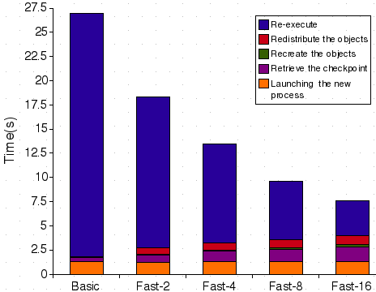
Message-Logging (cont.)
Fast Parallel restart performance:
Test: 7-point 3D-stencil in MPI, P=32, 2 ≤ VP ≤ 16
Checkpoint taken every 30s, failure inserted at t=27s
56
Notes:
56

Slide 57
Power
Power consumption is continuous
Normal Checkpoint-Resart method
Progress
Progress is slowed down with failures
Time

Slide 58
Power consumption is lower during recovery
Message logging + Object-based virtualization
Progress is faster with failures

Slide 59
HPC Challenge Competition
Conducted at Supercomputing
2 parts:
Class I: machine performance
Class II: programming model productivity
Has been typically split in two sub-awards
We implemented in Charm++
LU decomposition
RandomAccess
LeanMD
Barnes-Hut
Main competitors this year:
Chapel (Cray), CAF (Rice), and Charm++ (UIUC)

Slide 60
Strong Scaling on Hopper for LeanMD
Gemini Interconnect, much less noisy

Slide 61
CharmLU: productivity and performance
1650 lines of source
67% of peak on Jaguar

Slide 62
Barnes-Hut
High Density Variation with a Plummer distribution of particles
Won HPCC Class II (performance)

Slide 63
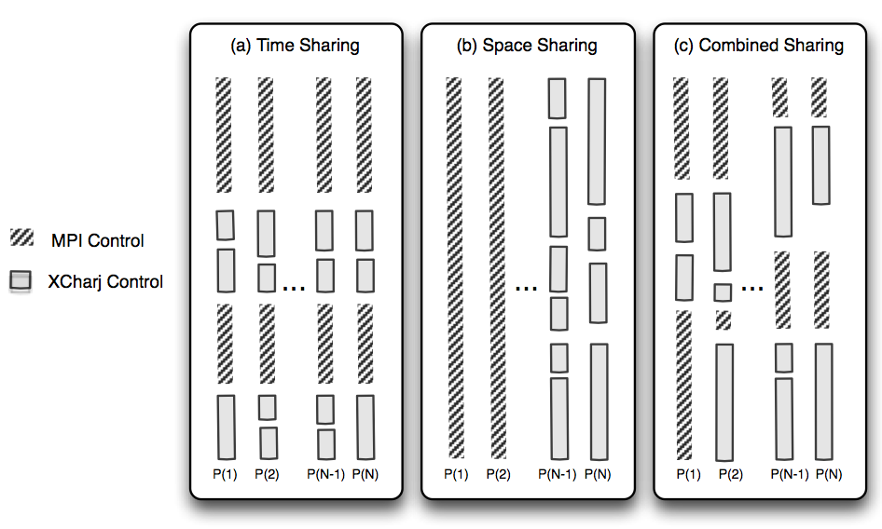
Charm++ interoperates with MPI
Charm++ Control

Slide 64
New Programming Models
Simplify parallel programming, improve productivity
Two broad themes:
Frameworks
Encapsulate common data-structure specific code
Or domain specific code
Avoids duplication/promotes reuse of expensive parallel software
Simpler but incomplete languages:
Restricting modes of interactions among parallel entities leads to simpler languages
Each language may be incomplete but:
Addresses important subclasses of algorithms
Together with other models, lead to a complete toolkit

Slide 65
Raising the Level of Abstraction
What we have seen so far, will help:
by automating resource management, FT, …
But: parallel interactions are still low-level
Clearly, we need new programming models

Slide 66
Simplifying Parallel Programming
By giving up completeness!
A paradigm may be simple, but
not suitable for expressing all parallel patterns
yet, if it can cover a significant classes of patterns (applications, modules), it is useful
A collection of incomplete models, backed by a few complete ones, will do the trick
Our own examples: both outlaw non-determinism
Multiphase Shared Arrays (MSA): restricted shared memory
LCPC ‘04
Charisma: Static data flow among collections of objects
LCR’04, HPDC ‘07

Slide 67
MSA: Multiphase Shared Arrays
Observations:
General shared address space abstraction is complex
Certain special cases are simple, and cover most uses
In the simple model:
A program consists of
A collection of Charm threads, and
Multiple collections of data-arrays
Partitioned into pages (user-specified)
Each array is in one mode at a time
But its mode may change from phase to phase
Modes
Write-once
Read-only
Accumulate
Owner-computes
C
C
C
C
A
B

Slide 68
Charisma: Static Data Flow
Observation: many CSE applications or modules involve static data flow in a fixed network of entities
The amount of data may vary from iteration to iteration, but who talks to whom remains unchanged
Notes:
User code contains as little parallel control flow as possible, eg. Physics, computation,

Slide 69
Charisma: Sequential-Parallel Separation
Program consists of
Orchestration (.or) code
Global flow of control and data
“Physics” code
Regular C++
User variables
Sequential methods
parallel
parallel
modules
Sequential Modules
Notes:
User code contains as little parallel control flow as possible, eg. Physics, computation,

Slide 70
Charisma++ example (Simple)
while (e > threshold)
forall i in J
<+e, lb[i], rb[i]> := J[i].compute(rb[i-1],lb[i+1]);

Slide 71
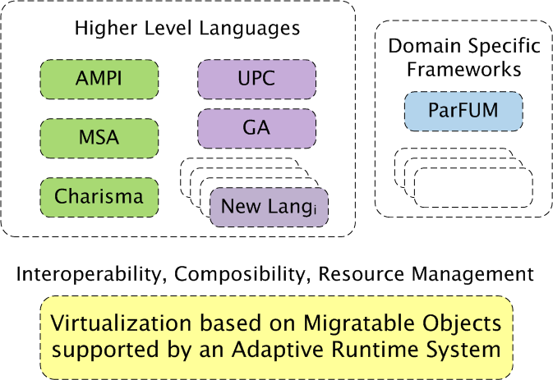
A View of an Interoperable Future
X10

Slide 72
Interoperability allows faster evolution of programming models
Evolution doesn’t lead to a single winner species, but to a stable and effective ecosystem.
Similarly, we will get to a collection of viable programming models that co-exists well together.

Slide 73
Compiler Support
Needed, but in a low-brow way
Not for auto-parallelization
A basic compiler infrastructure
Easy to extend
Allows code restructuring
Supports syntax that improves productivity
Basic, well-understood analyses
E.g. live-variables analysis for checkpointing
Inserting Control-points to provide knobs to RTS
Rose will be helpful in this context
Read also about the “CharJ” language

Slide 74
Summary
Do away with the notion of processors
Adaptive Runtimes, enabled by migratable-objects programming model
Are necessary at extreme scale
Need to become more intelligent and introspective
Help manage accelerators, balance load, tolerate faults,
Interoperability, concurrent composition become even more important
Supported by Migratable Objects and message-driven execution
Charm++ is production-quality and ready for your application!
You can interoperate with Charm++, AMPI, MPI and OpenMP modules
New programming models and frameworks
Create an ecosystem/toolbox of programming paradigms rather than one “super” language
More Info: http://charm.cs.illinois.edu/

Slide 75
More info
Charm++ Tutorial at SC: tut178
Sunday 830 am
“Parallel Programming with Migratable Objects for Performance and Productivity”
I invite you to:
Download charm++ and play with it
Manuals, online tutorial,
LLNL installation: /usr/global/tools/charm
Dotkits soon
Write your own load balancers(plug-in) and test on many existing apps
Consider using it for one of the modules of your app
More Info: http://charm.cs.illinois.edu/

